Slide 1
Lecture 6-1
Softmax classification:
Multinomial classification
Sung Kim <hunkim+mr@gmail.com>
http://hunkim.github.io/ml/

Slide 2
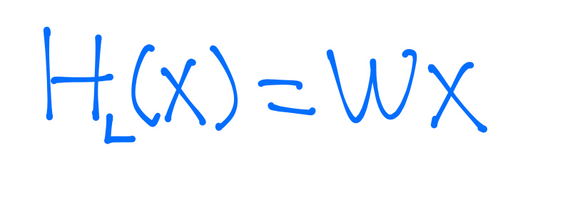
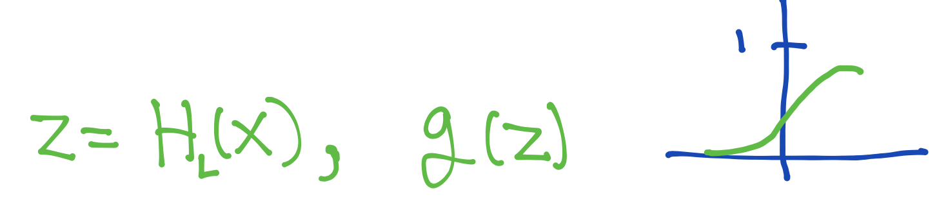
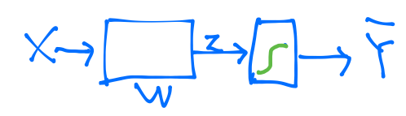
Logistic regression

Slide 3
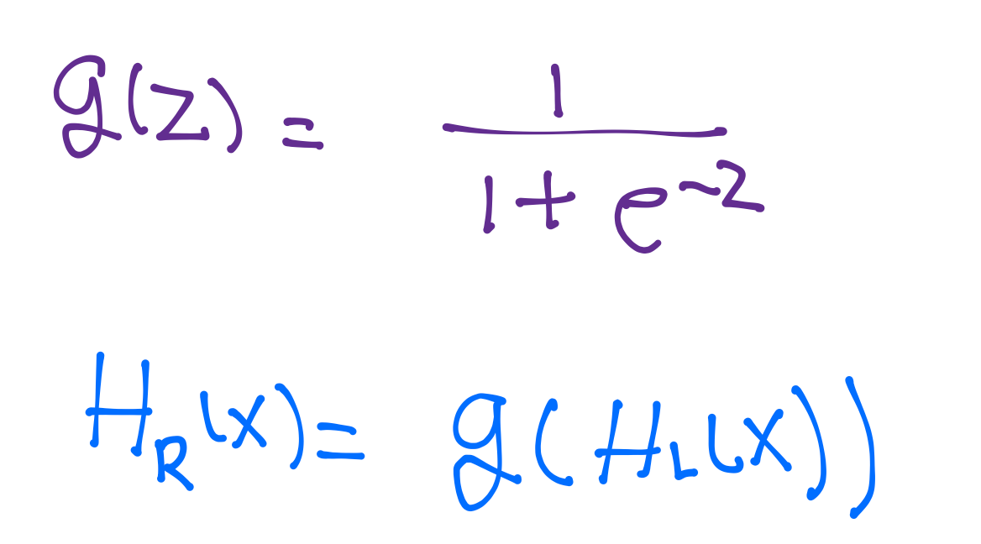
Logistic regression

Slide 4
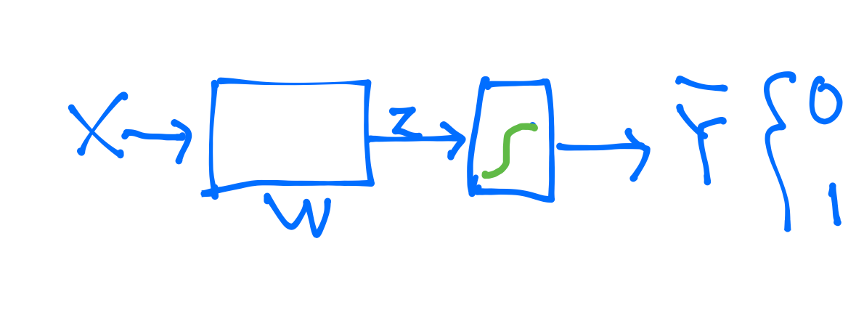
Logistic regression

Slide 5
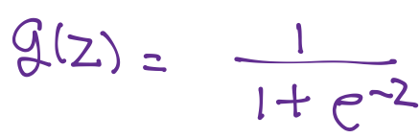
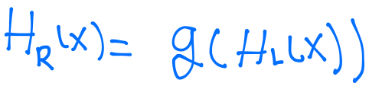
Logistic regression

Slide 6
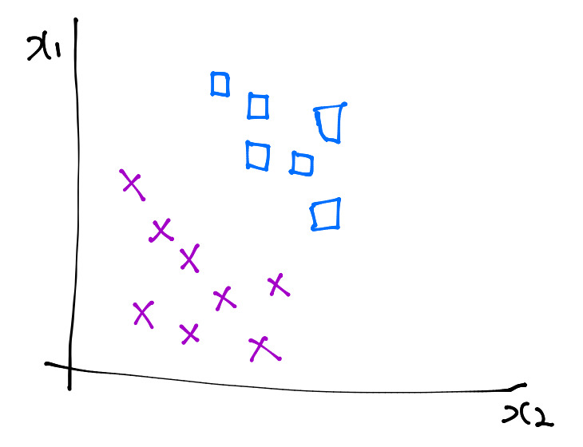
Logistic regression

Slide 7
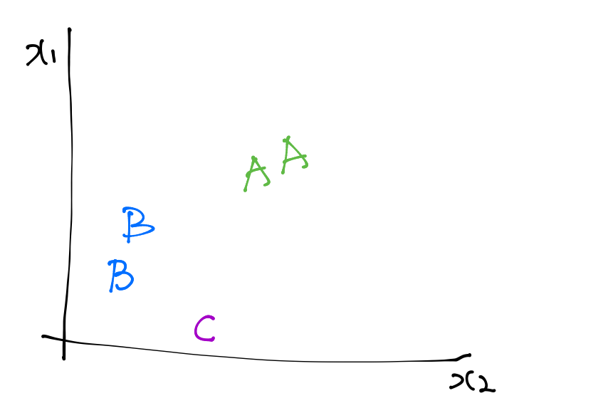
Multinomial classification
x1 (hours) | x2 (attendance) | y (grade)
10 | 5 | A
9 | 5 | A
3 | 2 | B
2 | 4 | B
11 | 1 | C

Slide 8
Multinomial classification

Slide 9
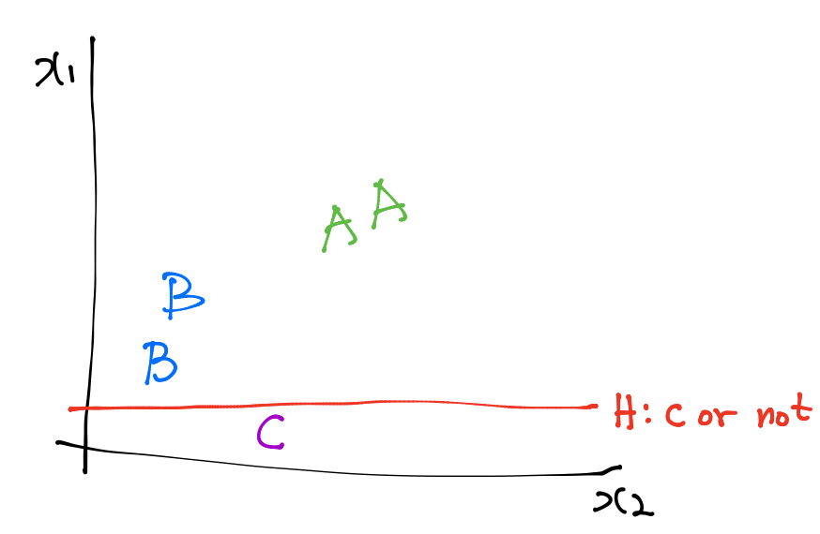
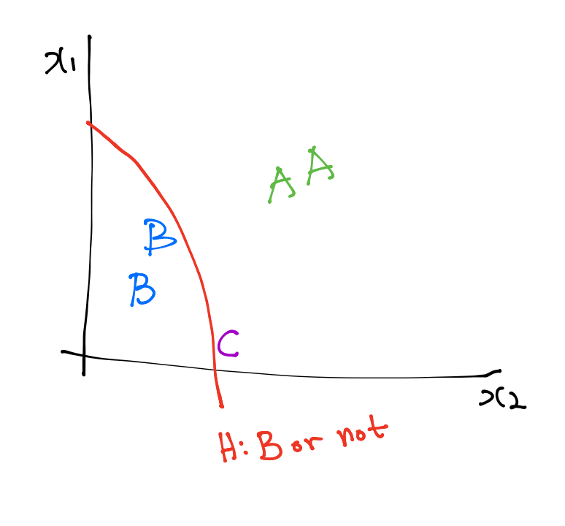
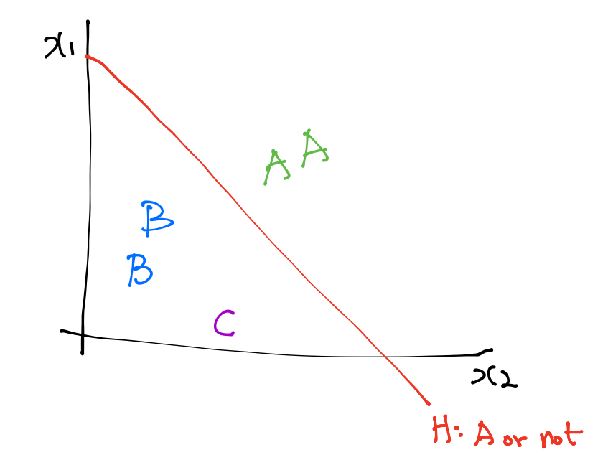
Multinomial classification

Slide 10
Multinomial classification

Slide 11
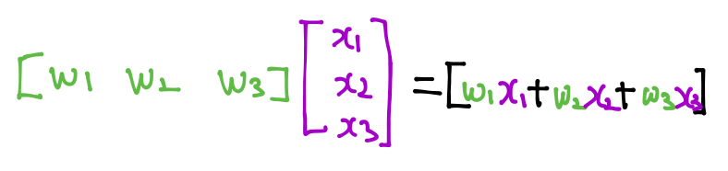
Multinomial classification

Slide 12
Multinomial classification

Slide 13
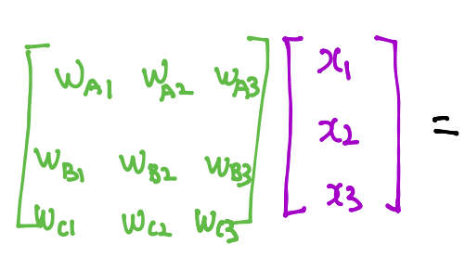
Multinomial classification

Slide 14
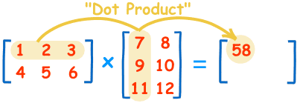
Matrix multiplication
https://www.mathsisfun.com/algebra/matrix-multiplying.html

Slide 15
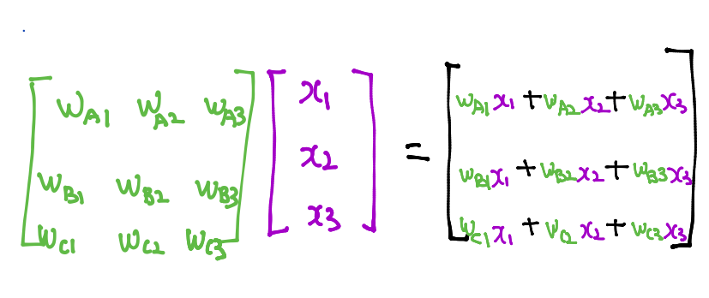
Multinomial classification

Slide 16
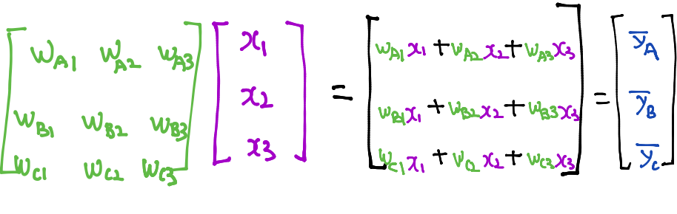
Multinomial classification

Slide 17
Where is sigmoid?

